Slide 1
Fall 2021 AP CS A
Lesson 12.5
Dr. O’Brien
Herbert H. Lehman High School
10 December 2021

Slide 2
Do now
be sure to: Get out your binder. Copy goal and answer do now questions below. Write a complete sentence for each answer:
Describe your favorite superhero.
What attributes would be associated with a SuperHero object?
Notes:
answers will vary.
power, type of costume, gender, +/- cape.

Slide 3
framing
what: combine classes using Constructors
why: We’ll learn to embed objects inside of other objects.
where to: documenting classes with comments

Slide 4
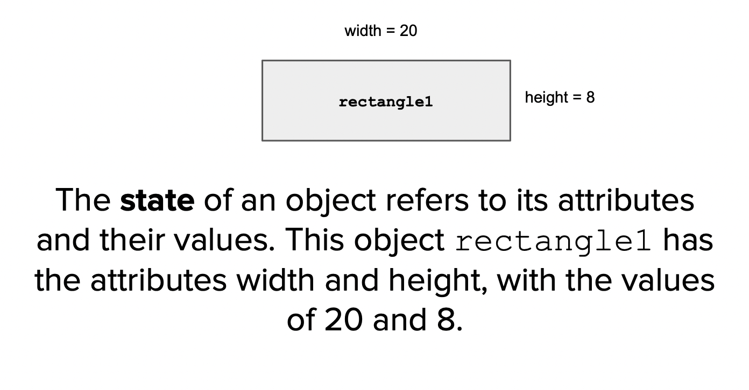
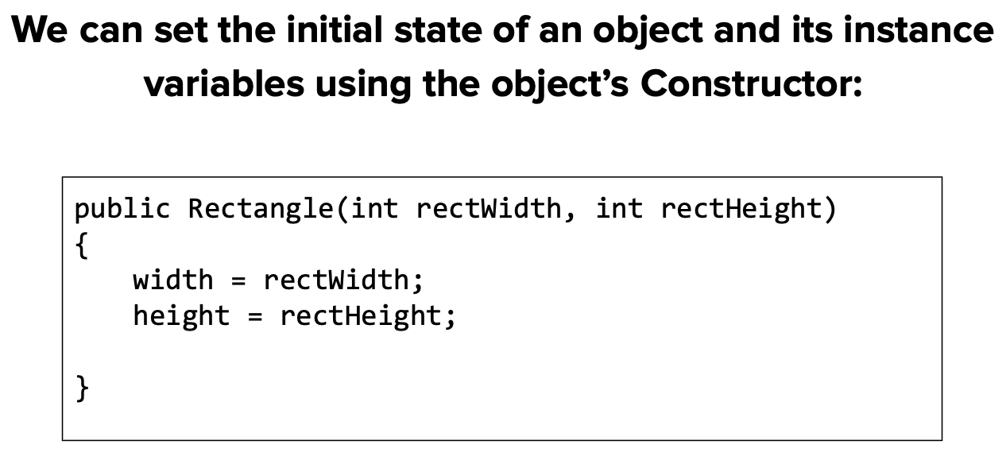
recap: object state
be sure to: Keep your notebook open. Copy info below.
We can call the data associated with an object its attributes

Slide 5
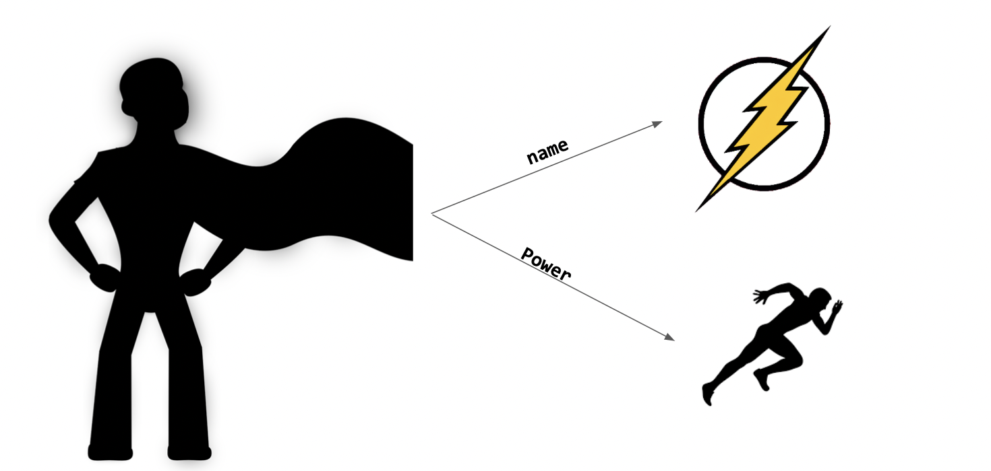
Writing to learn: warm up
be sure to: Keep your notebook open. Answer the questions below with a complete sentence for each. Be prepared to share out.
One attribute superheroes have is a power. What are some examples of superhero powers?
What are some attributes associated with a superhero’s powers. ?
Copy the diagram to the write in your notebook. How could we extend this diagram to represent the attributes associated with a Superhero’s powers.
Notes:
answers will vary.
name of the power, its strenght, etc.
copy diagram on board.

Slide 6
Coding to learn: Live coding
be sure to:
Log in to your workstation.
Open 12/10 SuperHero in In class examples. Be prepared to follow along with Dr. O’Brien (but see if you can stay one step ahead!
Notes:
public class MyProgram{
public static void main(String[], args){
Power oop = new Power("Object oriented programming", 10);
SuperHero java_man = new SuperHero("Java Man", oop);
}
}
+what do you notice about the relationship between the Power obj. and the superhero obj.? Power is an argument for the SuperHero constructor.
public class SuperHero{
private String name;
private Power power;
public SuperHero(String name, Power power){
}
}
public class SuperHero{
private String name;
private Power power;
public SuperHero(String name, Power power){
}
}
+HDW decide the private access settings for these atributes? discuss with class. power-strength should be accessible and modifiable, name should be accessible, power is accessible but not modifiable.
+What happens if we make a new superhero with the same power:
SuperHero c_plus_plus_boy = new SuperHero(“C++ boy", oop);
+what’s the problem here? power is pionting to the same object, which means that e.g. if we adjust the power-strngth for Java Man, we’ll also the change it for C++ boy.
instead, the SuperHero constructor will look like:
public class SuperHero{
private String name;
private Power power;
public SuperHero(String nname, Power ppower){
name = nname;
power = new Power(ppower.getName(), ppower.getStrength())
}
}

Slide 7
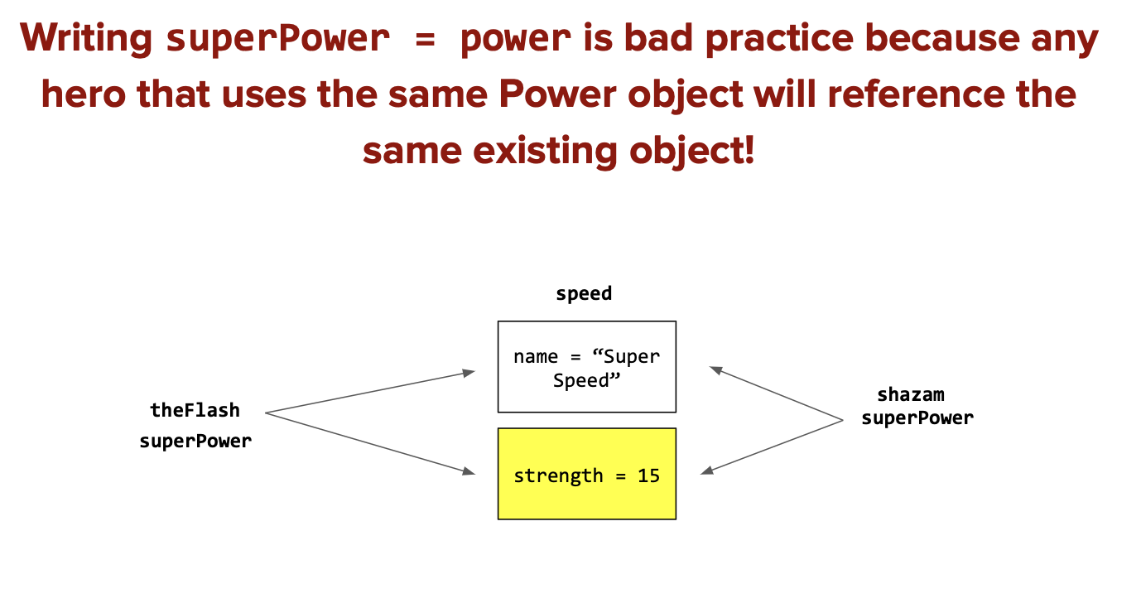
Notes:
This is because both theFlash’s superPower and shazam’s superPower reference the same speed object. Remember that when a variable is assigned the value of an object, it points to the existing object and does NOT create a new one. Because of this, whenever one of our SuperHeros changes the value of any speed attribute, it will affect the other SuperHero. When a variable is referencing an existing object, it is referred to as an alias of the original. In this case, both superPowers are aliases of the initial speed object.

Slide 8
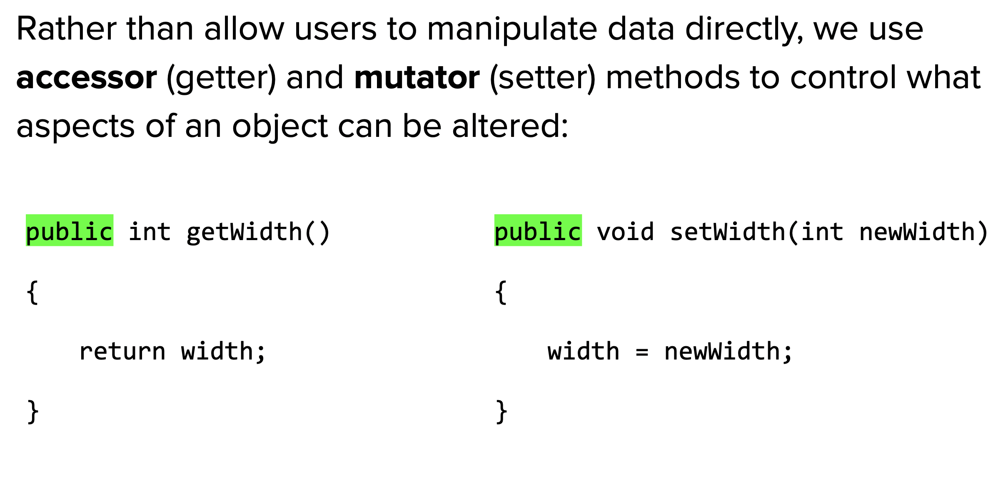
Coding to lean: Independent work
Remain your workstation. Read BSTs below.
be sure to:
Continue working on CodeHS lessons for 5.1 and 5.2
If you have a question, ask!
complete any remaining assignment for homework!
Getter method:
Setter method:

Slide 9
e
Reflection: Thinking about thinking
be sure to: Answer each question below in your notebook with a complete sentence. Be prepared to share out.
What was most challenging about building a SuperHero class?
How do you determine if information should be accessible, modifiable, both, or neither.
How is combining classes useful if we want to encapsulate information?
Notes:
it depends on what kind of information you have, if its something the user will want to know or change.
This helps us manage complexity in our programs. people should only have to worry about what they have to worry about!

